Slide 1
INTEL’s Middle out Journey to DEVOPS
MANISH AGGARWAL

Slide 2

AGENDA
Introductions, and what we do!
SW Process Requirements and Challenges
How ElectricFlow Helped
Solution Discussion
Q/A

Slide 3
About Myself
* Tech Lead Software at INTEL, Austin, TX
* 18+ years of software design/development experience
in Telecom and Networking
* Working at INTEL for 8 years in Data Center Group (DCG)
“I believe that quality products lead to happy customers, and
happy customers keep companies in business.”

Slide 4
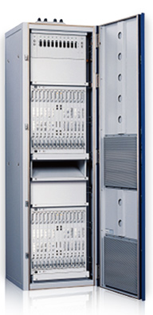
What we do!
Deliver System on Chip (SoC) to the top tier wireless telecom vendors in the world
So whenever you use your Smartphone, watch a YouTube Video, or communicate over an LTE network you are probably using some hardware or software that we built!

Slide 5

What was our challenge?
Business need to verify the HW part for a wide range of combinations.
10,000+ combinations – and growing with every release.
5 Software Platforms
16 Features
10 Chip Variants
Hundreds of Tests for each Engine

Slide 6




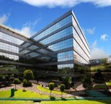
4
Releases/Year
DAYS
QA Lead Time per CI Cycle
85%+
Unknown Code coverage
3M
Lines of Code
100’s cases run/day
96
Permutations of S/W and H/W per product
Before
Notes:
8 branches
4 paths
3 platforms

Slide 7


Time to Market (TTM) or Quality?
Current cycle time
Testing takes more time with every release
But, need faster cycles for more frequent releases
Development
Testing
Development
Testing
Development
Testing
Options:
Increase cycles times and delay TTM?
Shorten cycle times and risk quality?
Test smarter and faster with automation!
Unacceptable gap…

Slide 8
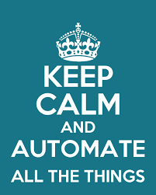
More reasons for Automation…?
Work is
The test count is of the order of 10,000+
Repetitive ; Monotonous ;
Still needs to be done!!
So, where do we start?
Home grown
Open-source
Commercial

Slide 9

How Electric Cloud Helped?
EC forms a single, flexible, scalable platform for us to design around
All tests automated using EC
Custom UI was developed to address specific product requirements
Test case selection based on multiple user-selected criteria
Execute set of test cases manually or on a schedule.
Results automatically emailed to stake holders

Slide 10

Parameterization to the rescue
The complete process of test selection was parameterized.
Release Branch
Engine/Feature
Sub Feature
Chip Type
Platform
The overall list of procedures is trimmed to the tests relevant to this selection by the user.

Slide 11

Standard, but custom
This vastly improves the maintainability.
The procedures visible are lot more manageable.
Individual users can save their customized test-lists.
Users can refer to the test-lists saved by other users.
The selected test cases can be :
executed as-is.
Modified
executed with different builds
Executed using different resources

Slide 12
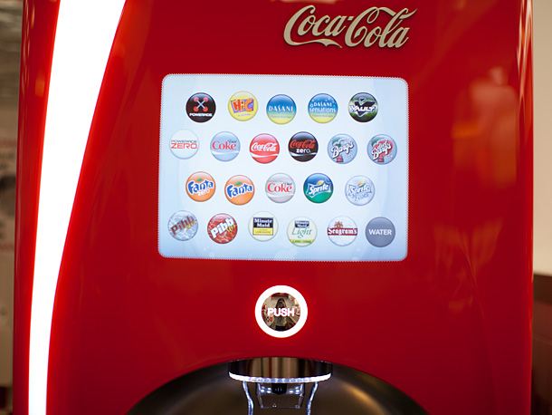
Self-Service
The peer teams can access the QA tests in a completely automated fashion
Developers can run the QA tests, against their sand-box. Even before check-in!!
Drastically reduces the possibility of feature-breakage

Slide 13

Feedback Loops
A file based email-notifier has been created.
The regression results are emailed to the pre-defined set of users, which includes engineers as well as management.
The email has all the information about the various tests and their results.
Also are the hyperlinks to the logs and test reports.
Easy to debug the failures, if any.

Slide 14
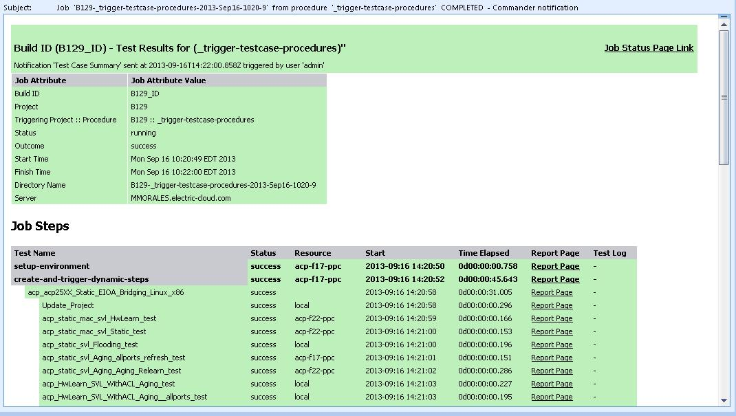
Email Notification

Slide 15
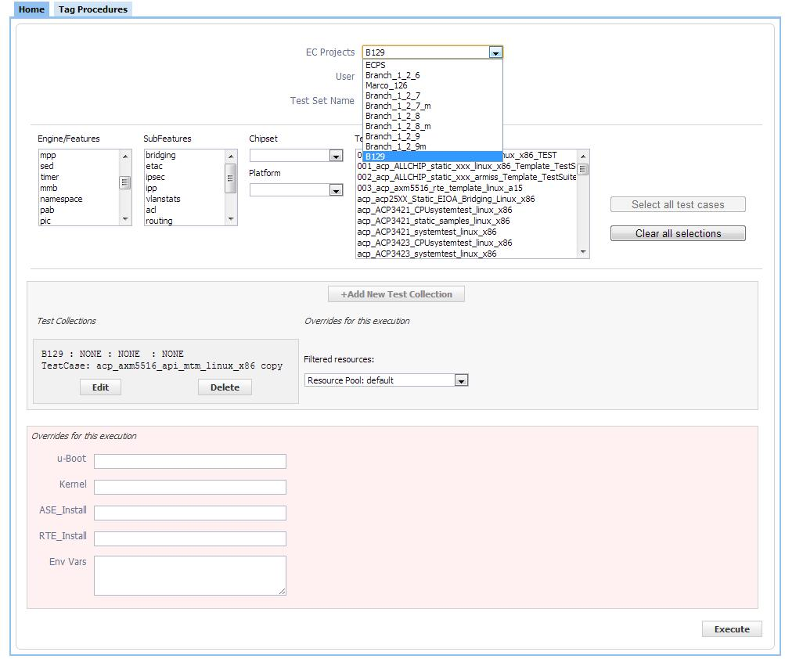
Selecting a Project
Notes:
The big win: This UI gives users the ability to collect their various test cases (in procedures) and save them, without having to create a library of wrapper procedures.
Describe how the selection process guides the user to select their test cases based on their input criteria.
Users can add one or more test cases into a test collection. And one or more test collections comprise a test set.
All selections are dynamic lists created from the data in the project itself.

Slide 16
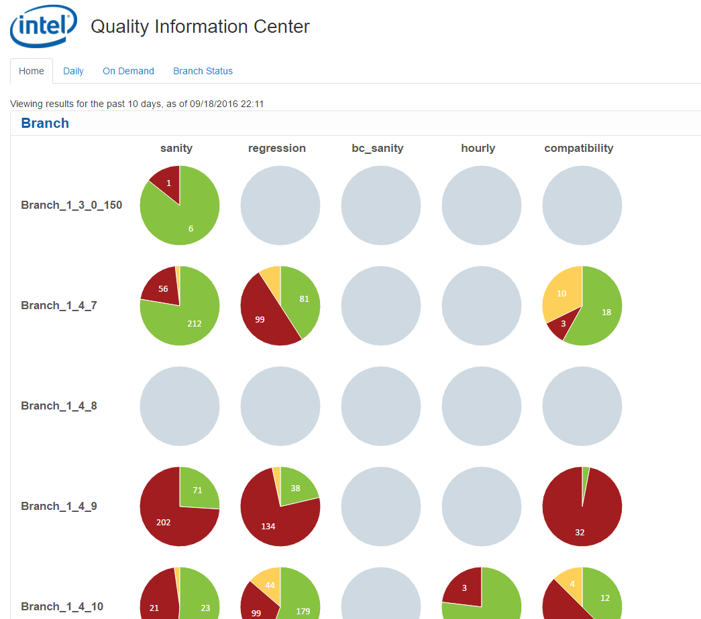
Result Dashboard
Notes:
Here, we have three test collections with various input filters.
The tests (hard to see) are set to run on different resources.
We have also overridden some environment variables for our user’s selection.

Slide 17
How does it all work: PROPERTIES
The default behavior is individual/standalone execution
Automation overrides these defaults
Examples are: email notifications, resources, operational parameters
Procedures supply information for data-driven execution
Create lists from the data in properties (e.g. Engine, Subfeature, Chipset, Platform)
Default operational parameters, overridden during automation
This way, we create dynamic and variable-length option lists
Users make their selection, and we pass the choices from the UI to a backend set of scripts
Notes:
EC Users should recognize that properties are currency in Electric Commander.
It was really important to permit users to run as before, and automation overrides default behavior and parameters.

Slide 18
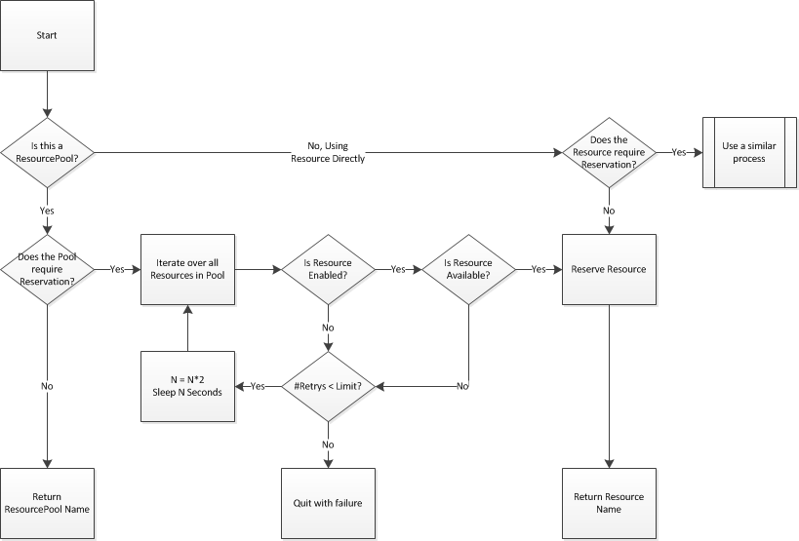
Hardware Reservation Process
Notes:
The major point is that we will use a Resource Pool or Resource depending on whether Hardware Reservation is required.

Slide 19

Bonus
Code coverage
Memory Leak
Binary Compatibility Verification

Slide 20
4
Releases/Year
DAYS
QA Lead Time per CI Cycle
100
Releases/Year
10min
QA Lead Time per CI Cycle
85%+
Unknown Code coverage
3M
Lines of Code
85%+
Known Code coverage
100’s cases run/day
96
Permutations of S/W and H/W per product
Before… After
12K
Test cases run/day
Notes:
8 branches
4 paths
3 platforms

Slide 21

Benefits
Helped manage the enormous amount of work, without increasing head-count.
Allowing frequent SW deliveries to our customers,
Continuous monitoring of the health of the product
More time at hand for test development
Clear handle on the Quality of the SW that is being shipped out of the doors

Slide 22
Conclusions
Time to Market pressures necessitate faster and more frequent releases
Quality is critical, requiring more testing with every release
The only solution is to test smarter and faster via automation
ElectricFlow enterprise capabilities to enable this
Flexibility
Reliability
Scalability

Slide 23
THANK YOU Q&A

